Slide 1

Cotton Crop Disease Detection With Deep Learning
By Muhammad Shadab

Slide 2
INTRODUCTION
World population is expected to be 10 billion in 2050. With more mouths to feed, agriculture needs to boost up to meet the food requirements. However, developing countries like Pakistan has seen a decline in their production of the crops. One of the main reasons behind declined in the production of the cotton crop is the damage caused by cotton diseases. Our model is giving farmers an easy and efficient method to diagnose cotton diseases and will recommend the usage of pesticides. It is based on machine learning, which learns with every use. Agriculture needs innovative ideas to increase its yield. Cotton Care (Cotton Crop Disease Detection using Deep Learning) is also one of the steps to integrate artificial intelligence into agriculture. The goal of this project is to help the farmers in decreasing the production cost and achieving the higher yield, which is also going to contribute to the country’s economy.

Slide 3
PROJECT TOOLS
Python
Jupyter Notebook
Datasets
Keras
Matplotlib
Flask
Kavascript
HTML
CSS

Slide 4

METHODOLOGY

Slide 5
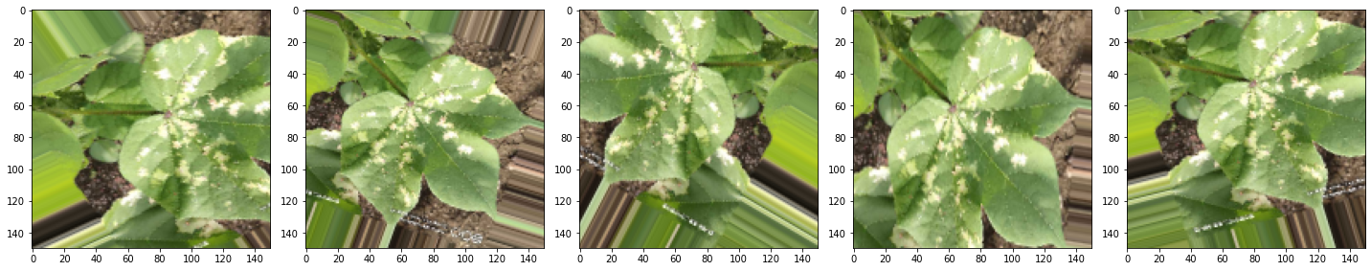
Image preprocessing:
Images in the dataset may be in different formats, quality and resolution. Hence, the images need to be preprocessed, for instance, images with smaller resolution and dimension less than 500 px will not considered as valid images for the dataset. The rest will be resized to 150 × 150 in order to reduce the time for training.

Slide 6

Training
In this step, training the deep convolutional neural network for making an image classification model will be done. Rectified Linear Units (ReLU) will subsequently be used as substitute for saturating nonlinearities. This activation function adaptively will learn the parameters of rectifiers and improve accuracy at negligible extra computational cost.

Slide 7
Convolutional Neural Network:
A convolutional neural network (CNN) is a type of artificial neural network used in image recognition and processing that is specifically designed to process pixel data.I searched for best algorithm to solve this problem and I select “Convolution Neural Network” (CNN). I create my own CNN architecture and it works well on the training and as well as testing dataset. It gives me more than 98% accuracy on training and validation data set in just 500 epochs. I am trying to increase accuracy with more data and epochs.

Slide 8

Rectified Linear Units (ReLU):
The Rectified Linear Unit is the most commonly used activation function in deep learning models. The function returns 0 if it receives any negative input, but for any positive value x it returns that value back. So it can be written as f(x)=max(0,x). Graphically it looks like this

Slide 9
Testing
In this phase, the test set for prediction of leaf as healthy/Unhealthy with its disease name will be used to evaluate the performance of the classifier.

Slide 10
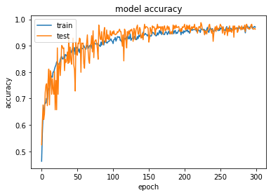
Model Accuracy:

Slide 11
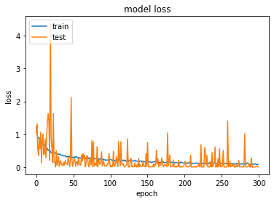
Model Loss

Slide 12
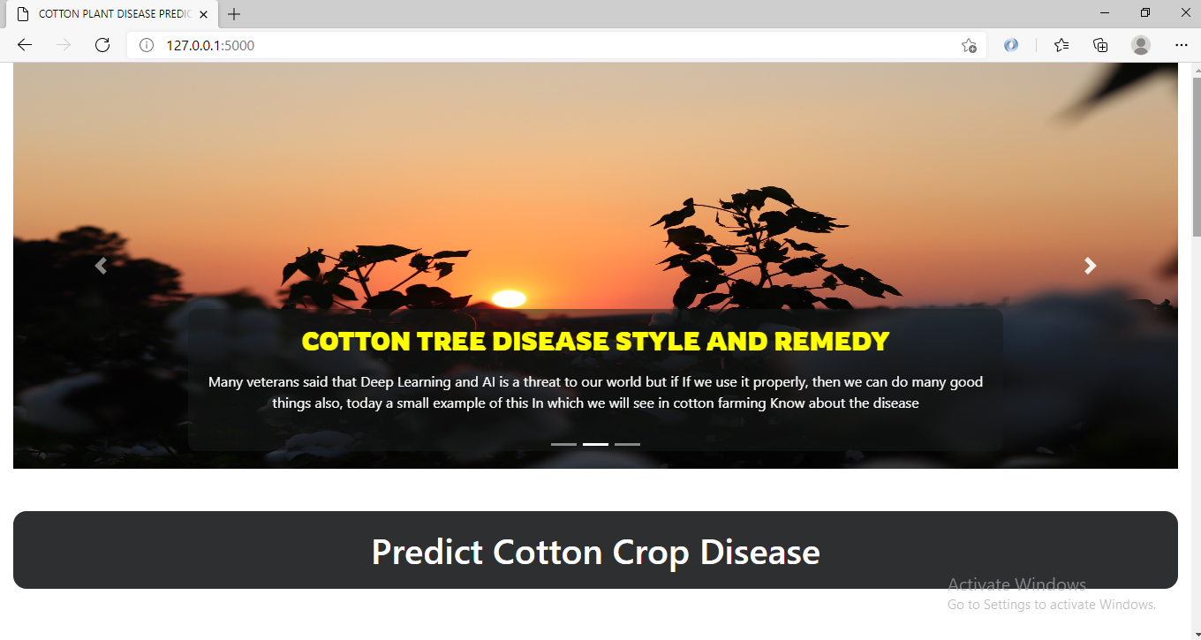
Web Application:

Slide 13
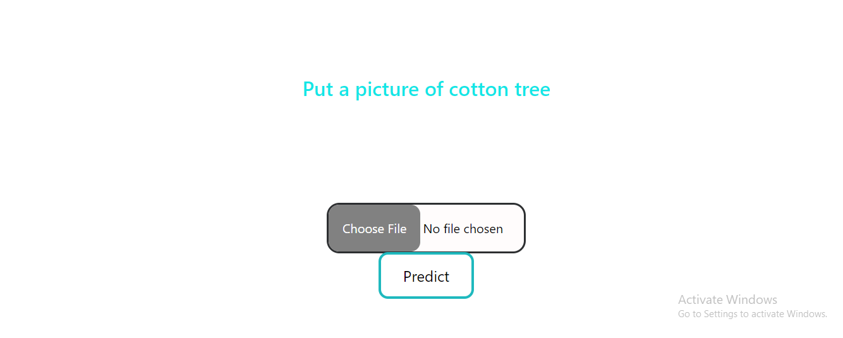
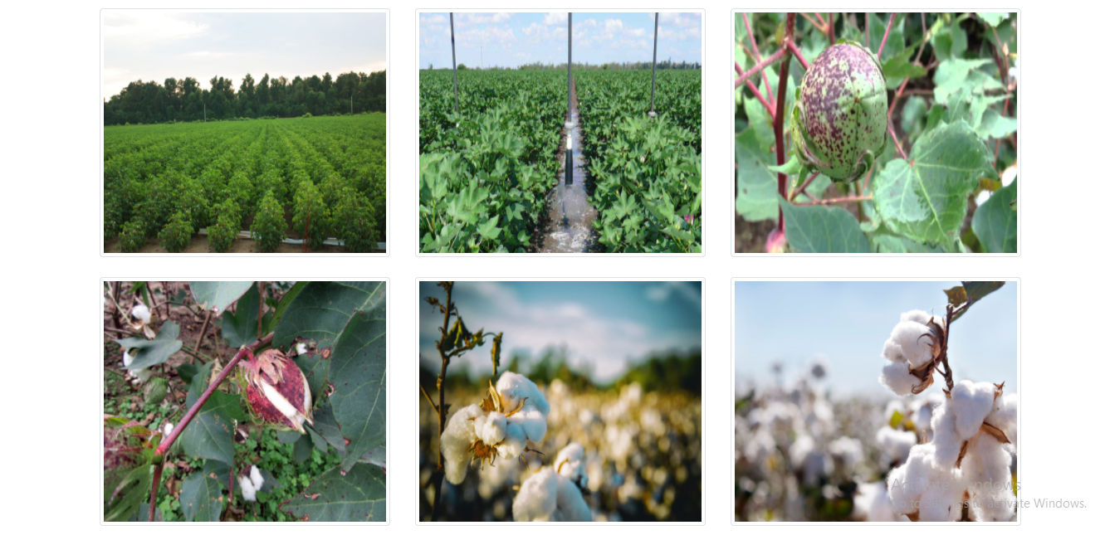

Slide 14
This is the main page of that web application. For putting the image click the Choose File. After putting in the image then the clicks Predict button. When click predict button the application shows me that the cotton leaf or plant is diseased or not.

Slide 15
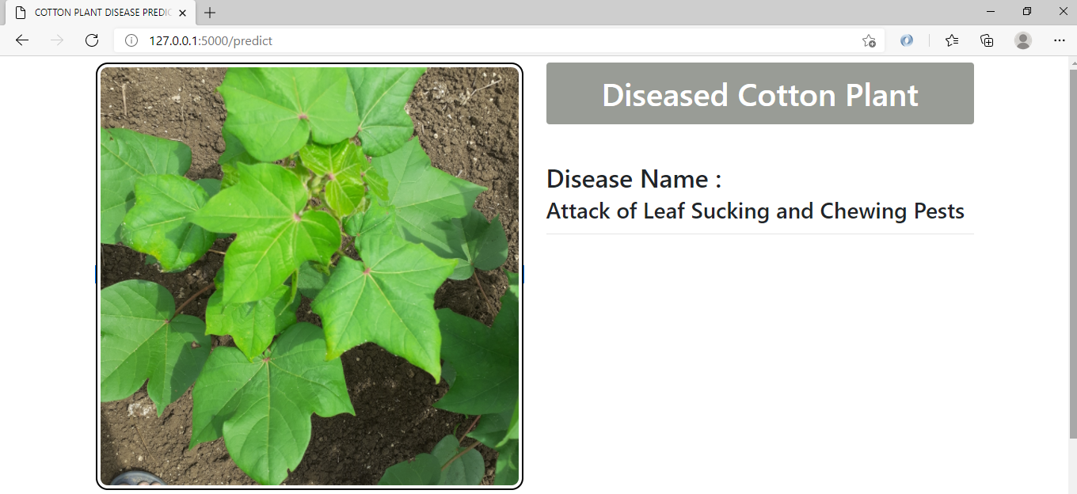

Diseased Cotton plant:
If we put the Diseased Cotton plant images that, show me this Cotton Plant Diseased and diseased name Attack of Leaf Sucking and Chewing Pests. And also show me this type of diseased solution.

Slide 16
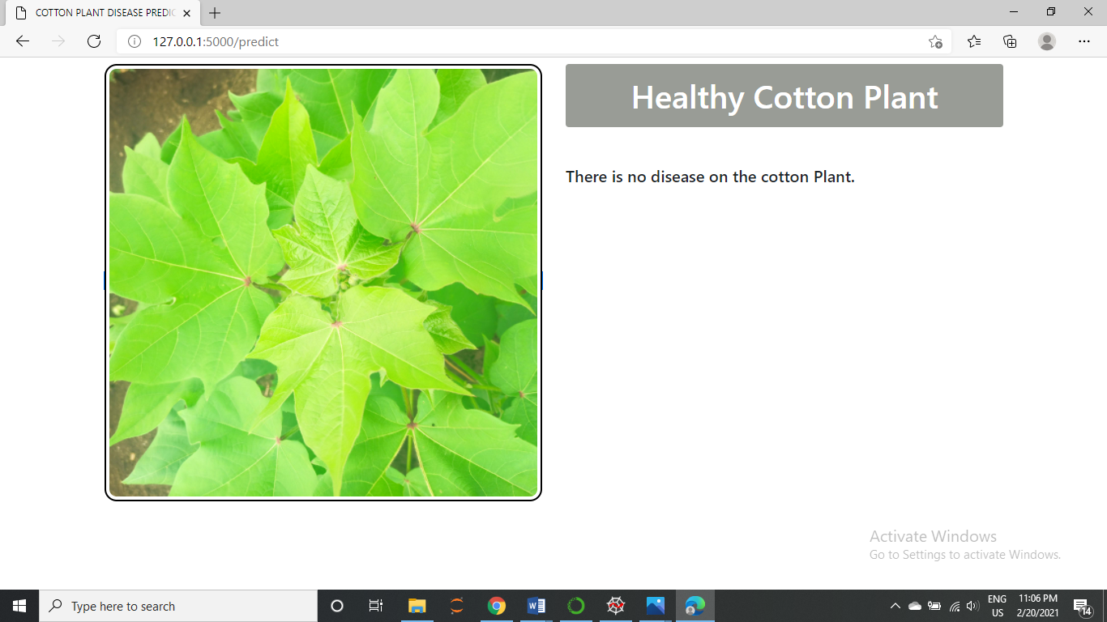
Healthy Cotton Plant:
If we put the healthy Cotton plant images that, show me there is no disease on the cotton Plant.

Slide 17
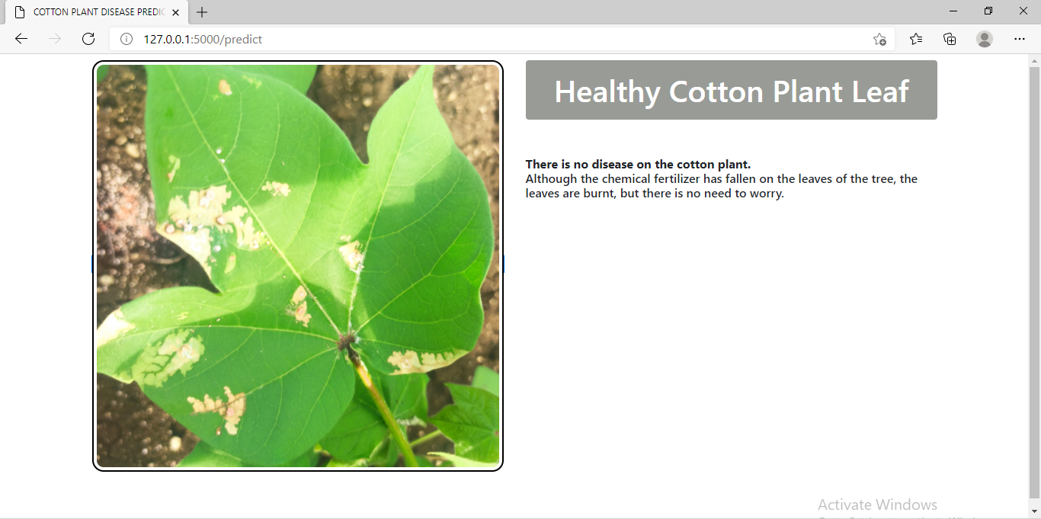
Healthy Cotton plant Leaf:
If the chemical fertilizer has fallen on the leaves of the leaf, then show me there is no disease on the cotton plant. Although the chemical fertilizer has fallen on the leaves of the tree, the leaves are burnt, but there is no need to worry.

Slide 18
ADVANTAGES & LIMITATIONS
Advantages:
a) Less expensive
b) Less time consuming
c) Not required any expert within plants field.
Limitations
The limitation(s) of the Project is/are:
a) Response depends upon the internet speed.

